Slide 1
Fact Constellation Schema

Slide 2
What is Fact Constellation Schema?
A fact constellation has multiple fact tables. It is also known as Galaxy Schema.
Multiple fact tables share dimension tables.

Slide 3
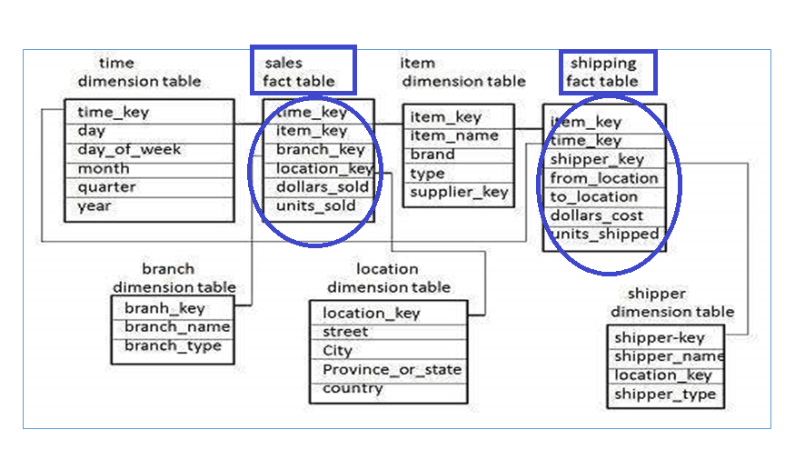
Example of Fact Constellation Schema

